Slide 1








Slide 2


Slide 3





Banavath Nataraj Naik
Ahmad Geelani
Jayashree Patra
Vinayak Goyal

Slide 4

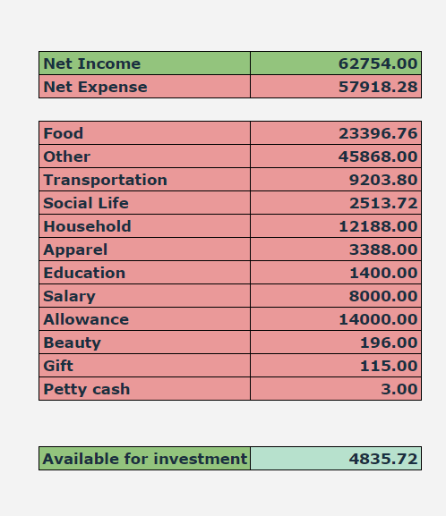
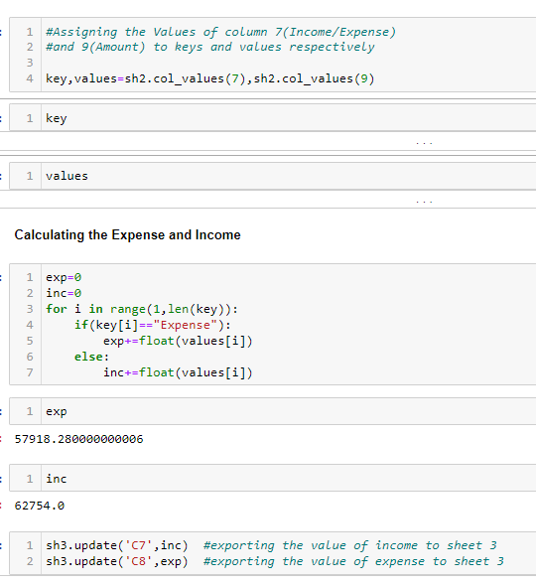








Computing Income/ Expense

Slide 5

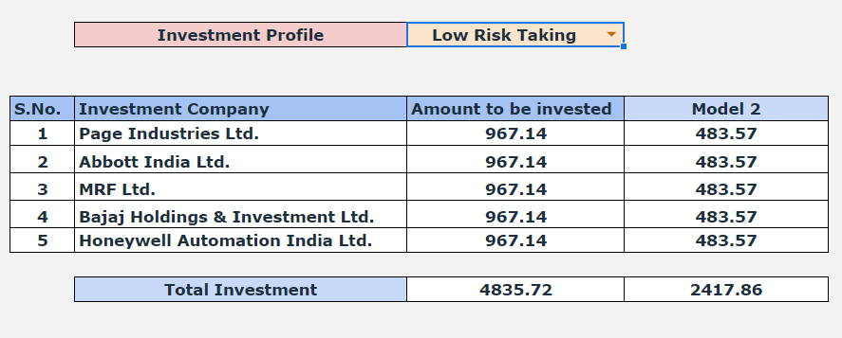
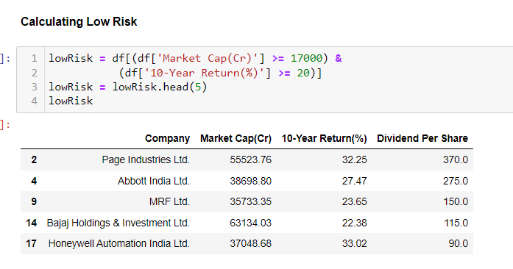
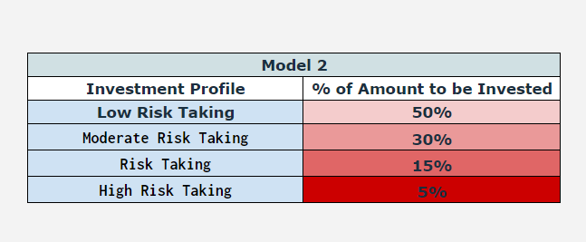
Investment Profile

Slide 6


Slide 7
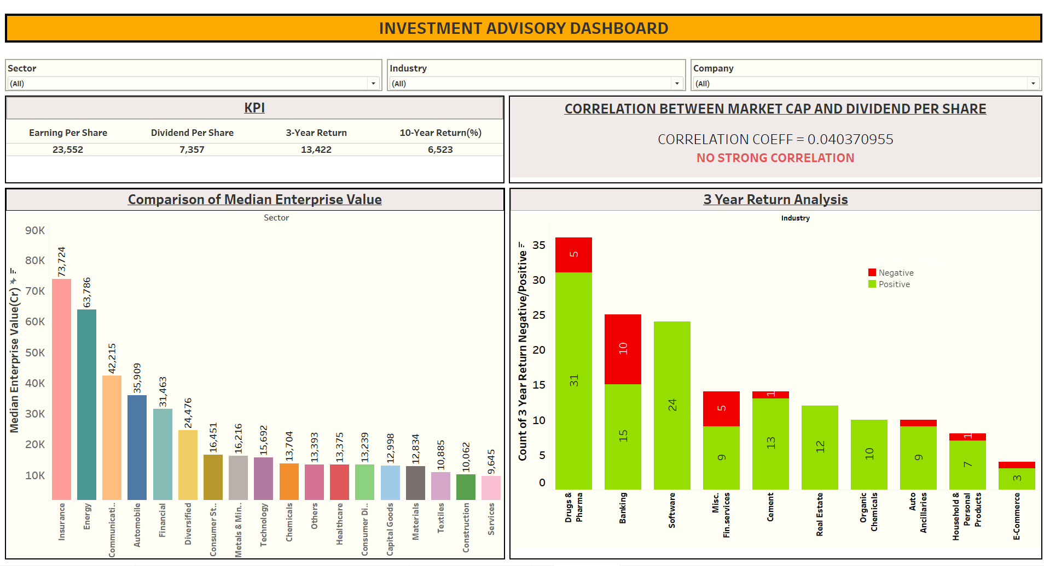

Slide 8
Insights and Conclusions
1. Companies with High EPS, DPS and Positive Year Return attracts more investors to invest
money.
2. Automobile Sector, Financial Sector have High EPS, good DPS, High Median of Enterprise value,
Year, 10-year Return is doing great and more promising than other sectors.
3. Sectors with Maximum Positive Count of Year Return and least Negative count of Return on
Years can be invested on.
4. Best return according to:
1 Week return - Tata Teleservices Ltd.
1 Month return - Suzlon Energy Ltd.
1 Year return - Adani Power Ltd.
3 Year Return - Ruchi Soya Industries Ltd.
5 Year Return - Ruchi Soya Industries Ltd.
5. Sanofi India Ltd. from Drugs & Pharma sector provides the Highest Dividend per Share of Rs 495.

Slide 9





The challenges & Learnings of the team
Challenges :
1.Connecting google sheets with python.
2.Comprehending the keywords of Stock Exchange.
3.Exporting the data to sheets.
4.Making the Risk Profile dynamic.
5.Identifying the KPIs.
Learning of the Team :
1. Learned how to make Python as a central unit to modify Gsheets.
2. Learned various skills among Team by sharing Knowledge during Project.
3. Time management.
4. Team work.

Slide 10



Slide 11


